Slide 1

OGC Standards for making geospatial data, maps and charts findable, accessible, interoperable, and reusable
Technical foundations of OGC standards
Prof. Dr. Franz-Josef Behr
Stuttgart University of Applied Science
ICA Commission on SDI and Standards
Notes:
I would like to make a presentation at ICC 2023. Unfortunately I cannot deliver a paper, but the topic should be very interesting and should be included in the "map and the internet" sessions if accepted. I have been told that as of today you have too few presentations for the conference.
OGC API - Features is a standard that offers the ability to create, modify and search for spatial data. In previous standards, so-called APIs were only machine-readable, but the new standard also offers a human-readable and cartographic entry where you can familiarize yourself with the data. Related data can also be chained together so that one can walk through the objects in the data set / model.
Why a new standard?:
- Easier and direct access and search of geodata (both human-readable and machine-readable)
- Custom modern web development (Javascript, JSON)
- Constructed as "building blocks" that can be used to assemble new APIs
There are several implementations of the standard and I will show examples from "ldproxy" which is implemented by "Interactive instruments" -https://interactive-instruments.github.io/ldproxy/
I will show examples of:
- filtering (search) both human- and machine readable
- navigation in the datasets and linked datasets
- how to build chartography (symbolization)
Finely I will disuss:
- complex data and properies
- import in QGIS & ArcGIS
Kind Regards
Sverre Iversen
Geological Survey of Norway
Commission on Maps and the Internet
sverre.iversen@ngu.no
Tel +4741688041

Slide 2
Outline
Introduction and fundamental concepts
  Service-oriented Architecture (Client-Server-Architecture)
  Identification: URI and URL
  HTTP: Operations, Status Codes
  REST
  Content-Type
Encodings: From XML and GML to (Geo-)JSON and YAML
Examples
Summary

Slide 3

The Web: Small but powerful standards
„It's not often in standardization that you can actually simplify something."
Sir Tim Berners-Lee [1]
https://commons.wikimedia.org/wiki/File:ODISummit_4Nov_116_(15707890451).jpg
Transfer protocol: Hypertext Transfer Protocol, HTTP
Uniform identification schema: Uniform Resource Identifiers (URI)
Document format: (eXtensible) Hypertext Markup Language, (X)HTML
Information resources themselves
  Information resources must be identifiable (per name, per address / location)
  Identification schema (string!) must be expandable and complete.
[1] http://xml.coverpages.org/xmlPapers2000Q4.html

Slide 4
Architectural Concept
Principles
Tiers
Underlying standards

Slide 5

Service-oriented architecture
important
DNS Server
IP address
IP address / Server Name / Host name
Client
"User Agent"
HTTP Server
Document root
Static
resources
HTTP-Client
HTTP-Client
HTTP-Client
HTTP
HTTP
80
Internet
80
Communication Tier,
Web Tier
PNG, JPG, …
XML / SVG
Presentation Tier
CGI protocol
Application
Server
Server side programs
Dynamic Generation of resources
Local System
(GIS)
SQL
Data collection, preparation, analysis
DBMS
Server
Data Tier
like Geodata
Notes:
The architecture describes the structure and behavior of an application. It defines the framework in which an application is built.
According to Fielding: The client-server style is the most frequently encountered of the architectural styles for
network-based applications
At the heart of software architecture is the principle of abstraction: hiding some of the
details of a system through encapsulation in order to better identify and sustain its
Properties (M. Shaw. Toward higher-level abstractions for software systems. Data &
Knowledge Engineering, 5, 1990, pp. 119–128 cited by Fielding 2000)
By separating the user interface concerns from the
data storage concerns, we improve the portability of the user interface across multiple
platforms and improve scalability by simplifying the server components.
Perhaps most significant advantage is that the separation allows the components to be implemente evolve
independently, thus supporting the Internet-scale requirement of multiple organizational
domains.
A “primary disadvantage of layered systems is that they add overhead and latency to
the processing of data, reducing user-perceived performance.” (Fielding)

Slide 6
Service-oriented architecture
important
DNS Server
Identification
Transfer of
Encoded Information
IP address
URI
RFC 1630
IP address / Server Name / Host name
Client
"User Agent"
HTTP
RFC 2616
Content-Type
RFC 2045
HTTP Server
Document root
Static
resources
HTTP-Client
HTTP-Client
HTTP-Client
HTTP
HTTP
80
Internet
80
Communication Tier,
Web Tier
XML
w3.org/XML/
PNG, JPG, …
XML / SVG
Presentation Tier
CGI
RFC 3875
CGI protocol
Application
Server
Server side programs
Dynamic Generation of resources
Local System
(GIS)
Encoding
now:
towards JSON
SQL
ISO/IEC 9075
SQL
Data collection, preparation, analysis
DBMS
Server
Data update and
retrieval
Data Tier
like Geodata
Notes:
The architecture describes the structure and behavior of an application
It defines the framework in which an application is built. open, non-proprietary internet standards,
in particular the World Wide Web (WWW) standards HTTP, Uniform Resource Locators (URLs), Content Types and to a large extent the Extensible Markup Language (XML)

Slide 7
URI - the Uniform Resource Locator (URL)
important
Query Delimiter
Fragment Delimiter
Key-Value-Pair (KVP)
http://www.gis-news.de:80/maps/showmap.php?country=Greece&region=all#Athens
Protocol
Host
Port
(optional)
URL Path
different purpose in
OpenAPI context
Query String
Fragment
Not all characters are allowed:
http://geoweb.hft-stuttgart.de/cgi-bin/mapserv.exe?img.x=348&img.y=318&zoomdir=1&zoomsize=2&layer=St%E4dte&layer=motorway&layer=roads&layer=Fl%FCsse&layer=H%F6henstufen&layer=Europe&map=C%3A%2FProgramme%2FApache+Group%2FApache%2Fhtdocs%2Fdemo.map&imgext=4.296614+49.186302+7.284114+52.174938&imgxy=274.5+274.5
Notes:
The key abstraction of information in REST is a resource. Any information that can be
named can be a resource: a document or image, a temporal service (e.g. “today’s weather
in Los Angeles”), a collection of other resources
identifiers should
change as infrequently as possible.

Slide 8
Content-Type – a little bit hidden, but important!
Originally intended for e-mail attachments, the so-called multipart mails, Multipurpose Internet Mail Extensions (MIME) were conceptualized.
Standardized in RFC 2046, RFC 2047, RFC 4288, RFC 4289 and RFC 2049
The MIME specification informs about the data type of the respective part of the mail, i.e. the structure of the data in the email message.
However, this information is not only useful for e-mails - almost always, when remote programmes (e.g. web clients and web server) communicate with each other because of an upcoming data transmission, it is also about the type of data to be transmitted and interpreted.
Now the preferred term is Content-Type.

Slide 9
Content-Type
important
Two parts: Media type + Subtyp, separated by „/“
Essential media types (see https://www.iana.org/assignments/media-types/media-types.xhtml):
  text = for text files
  image = for graphic files
  video = for video files
  audio = for sound files
  application = for resources requiring a specific programme for further processing
    Eamples:
      text/xml
      application/json
  multipart = for multipart data
  message = for messages

Slide 10
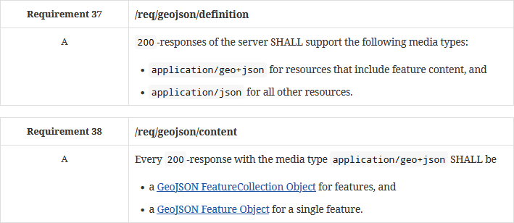
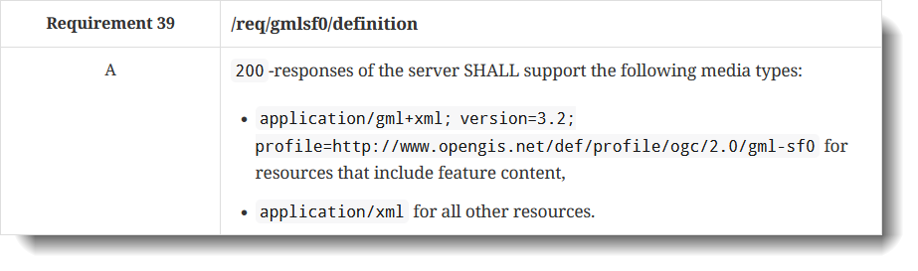
Content-Type in OpenAPI
important
http://docs.opengeospatial.org/is/17-069r3/17-069r3.html

Slide 11
HTTP
Principles
Codes
Operations

Slide 12
Definition
A communication protocol is a system of rules that allows two or more entities of a communications system to transmit information.
The protocol defines the rules, syntax, semantics and synchronization of communication and possible error recovery methods.
Protocols may be implemented by hardware, software, or a combination of both
https://en.wikipedia.org/wiki/Communication_protocol [2021-03-11]

Slide 13

Open Systems Interconnection model (OSI model)
Communication Partner A
Communication Partner A
Internet
Application
7
Application
HTTP, FTP, …
Interface
6
Presentation
Presentation
Interface
5
Session
Session
4
Transport
Transport
3
Network
Network
2
Data link
Data link
Bits and Bytes
1
Physical
Physical
Physical Media
Notes:
At the heart of software architecture is the principle of abstraction: hiding some of the
details of a system through encapsulation in order to better identify and sustain its
Properties (M. Shaw. Toward higher-level abstractions for software systems. Data &
Knowledge Engineering, 5, 1990, pp. 119–128 cited by Fielding 2000)
According to https://en.wikipedia.org/wiki/OSI_model:
The Open Systems Interconnection model (OSI model, defined in ISO/IEC 7498) is a conceptual model that characterises and standardises the communication functions of a telecommunication or computing system without regard to its underlying internal structure and technology.
Its goal is the interoperability of diverse communication systems with standard communication protocols. The model partitions a communication system into abstraction layers. The original version of the model had seven layers.
A layer serves the layer above it and is served by the layer below.
The application layer is the layer of the OSI model that is closest to the end user, which means both the OSI application layer and the user interact directly with a software application that implements a component of communication between the client and server
The Physical converts the digital bits into electrical, radio, or optical signals.

Slide 14
Basic HTTP Operation
Protocol Version
Status Code
Response Headers
Response Body
Client
"User Agent"
Server
HTTP-
Browser
80
HTTP server
80
Request Method
URL / Relative URL
Request Headers
Request Body

Slide 15
Request-Reponse-Cycle
Many of the request header fields for proactive negotiation use a common parameter […] "q", to assign a relative "weight" to the preference for that associated kind of content.
https://tools.ietf.org/html/rfc7231#section-5.3.1
URL Size (length of query string) limited due
to client-side/server-side restrictions, i.e. 2048 characters
GET Request
Response
HTTP Header
GET /books/index.html HTTP/1.1
Host: www.gis-news.de
User-Agent: Mozilla/5.0 Gecko/20100101 Firefox/30.0
Accept: text/html,application/xhtml+xml,application/xml;q=0.9,*/*;q=0.8
Accept-Language: de,en-US;q=0.7,en;q=0.3
Empty
line
HTTP Body
Empty in this case!
The Accept-Language request-header field is similar to Accept, but restricts the set of natural languages that are preferred as a response to the request.
https://www.w3.org/Protocols/rfc2616/rfc2616-sec14.html#sec14.4
Content-Type
HTTP/1.1 200 OK
Date: Mon, 23 May 2017 22:38:34 GMT
Server: Apache/1.3.3.7 (Unix) (Red-Hat/Linux)
Last-Modified: Wed, 08 Jan 2013 23:11:55 GMT
Content-Type: text/html; charset=UTF-8
Content-Length: 115
Connection: close
<html><head><title>An Example Page</title></head>
<body>
A very simple HTML document.
</body></html>
HTTP Header
Empty
line
HTTP Body
Data for the representation of a resource

Slide 16
POST-Request
POST Request
HTTP Header
POST /wiki/Spezial:Search HTTP/1.1
Host: de.wikipedia.org
Content-Type: application/x-www-form-urlencoded
Content-Length: 22
search=Stuttgart&go=Artikel
Empty
line
HTTP Body
Size unlimited!

Slide 17
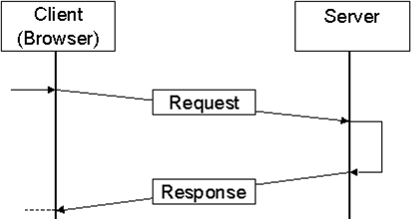
HTTP Basics
A standardized application layer protocol for distributed, collaborative, and hypermedia information systems (http://tools.ietf.org/html/rfc2616 (1969))
Request-Respond approach
Stateless protocol: communication does not require the HTTP server to retain information or status about each user for the duration of multiple requests
  Benefit: Scalability
  Disadvantage: Additional approaches needed
Multimedia-orientation
  Any kind of data can be transfered using HTTP
  Client and server must be able to handle different data and use Content-Type information
Recommended reading: HTTP/2: Background, Performance Benefits and Implementations. https://www.sitepoint.com/http2-background-performance-benefits-implementations/ [2023-03-14]
Notes:
each request contains all of the
information necessary for a connector to understand the request, independent of any
requests that may have preceded it.

Slide 18
HTTP Operations (or „verbs“)
cf. CRUD in DBMS technology:
CREATE
READ
UPDATE
DELETE
GET: requests a representation of the specified resource without side effects.
HEAD: similar to GET request, but only for retrieval of meta-information in the response header.
POST: requests that the server accept the entity enclosed in the request as a new part of the web resource identified by the URI, i.e., an annotation for existing resources; block of data submitted using a web form to a data-handling process; or an item to add to a database.
PUT: enclosed entity should be stored under the supplied URI. If the URI refers to an already existing resource, it is modified; if the URI does not point to an existing resource, server can create the resource with that URI.
DELETE: deletes the specified resource.
TRACE: echoes the received request so that a client can see what (if any) changes or additions have been made by intermediate servers.
OPTIONS: returns the HTTP methods that the server supports for the specified URL, i.e. to check the functionality of a web server.
CONNECT: converts the request connection to a transparent TCP/IP tunnel, usually to facilitate SSL-encrypted communication (HTTPS) through an unencrypted HTTP proxy.
PATCH: applies partial modifications to a resource
[1] https://stackoverflow.com/questions/812925/what-is-the-maximum-possible-length-of-a-query-string?
utm_medium=organic&utm_source=google_rich_qa&utm_campaign=google_rich_qa

Slide 19
HTTP Status Codes
important
HTTP-Status Code | Explanation
200 | “OK”: The server can send the requested data as requested -the normal case if no problems occur.
201 | Request has succeeded and has led to the creation of a resource – “CREATE”
202 | “ACCEPTED”
204 | “No content”: Server has received the request but is not sending data back. Suited for use in server-side scripts that do something on the server but do not want to send a representation – in case of “DELETE” or “UPDATE”
301 | „Moved Permanently“: The requested resource is no longer under the URI, it has been permanently moved to another address. The status message (statusText property) indicates under which URI the data is now located.
302 | Similar to 301. The requested resource has been temporarily moved to another URI. The status message (property statusText) indicates at which address the data is currently located.
304 | „Already sent“: The requested data has not changed from a previous request and therefore will not be sent again
400 | „Bad Request“: Request contains syntax errors and the server cannot process the request. Happens easily ;-)
401 | “Unauthorized”: The requested resource is access-protected. Server can only send the data if a valid access ID consisting of user name and password is sent with the request.
403 | “Forbidden“: similar to 401 (like request from forbidden IP address range, blocked resource has no directory listing…
404 | „Not found“: The requested resource cannot be found.
500 | „Internal Server Error“: The server cannot send the requested data because a serious error has occurred on the server. This is often a configuration problem of the HTTP server or other components (e.g. with information on interpreters).
Notes:
The server can send the requested data as requested -the normal case if no problems occur.
The server does not want to give out the requested data. This happens, for example, if access to the resource from the IP address range from which the request comes has been forbidden in the server configuration, the resource has been blocked altogether, or one is trying to get a directory listing but this has been switched off in the server configuration.

Slide 20
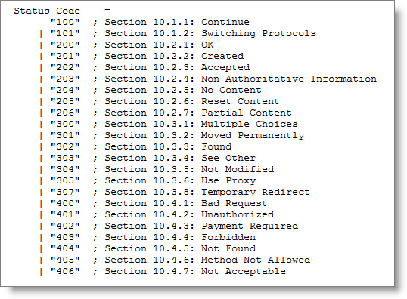
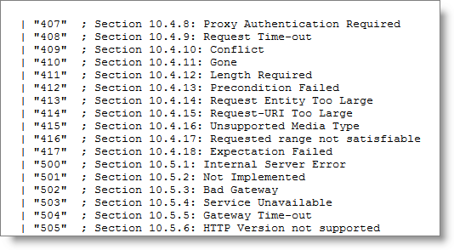
HTTP Status codes (complete)
http://www.rfc-editor.org/rfc/rfc2616.txt

Slide 21
Status Code and Open API
important
http://docs.opengeospatial.org/is/17-069r3/17-069r3.html

Slide 22
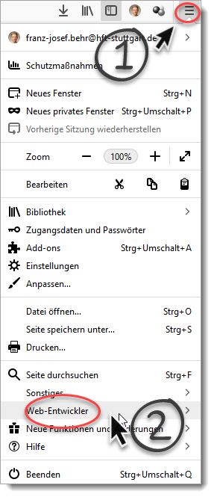
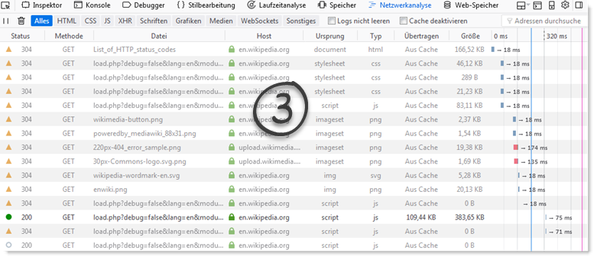
Web browser: Developer Tools to Track HTTP Communication
Extremly powerful!
Essential for your professional work!

Slide 23
GET vs. POST
 | GET | POST
BACK button/Reload | Harmless | Data will be re-submitted (the browser should alert the user that the data are re-submitted)
Bookmarked | Can be bookmarked | Cannot be bookmarked
Cached | Can be cached | Not cached
Encoding type | application/x-www-form-urlencoded | application/x-www-form-urlencoded or multipart/form-data. Use multipart encoding for binary data
History | Parameters remain in browser history | Parameters are not saved in browser history
Restrictions on data length | data are part of the URL whose length is limited (max length theoretically 2048 characters, but see [1]) | No restrictions
Restrictions on data type | Only ASCII characters allowed | No restrictions. Binary data is also allowed
Security | Somehow less secure compared to POST: data sent visible as part of the URL | a little safer than GET because the parameters are not stored in browser history or in web server logs
Visibility | Data is visible to everyone in the URL | Data is not displayed in the URL
[1] https://stackoverflow.com/questions/812925/what-is-the-maximum-possible-length-of-a-query-string?
utm_medium=organic&utm_source=google_rich_qa&utm_campaign=google_rich_qa
Source: after https://www.w3schools.com/tags/ref_httpmethods.asp

Slide 24
REST
GetCapabilities
GetFeature

Slide 25
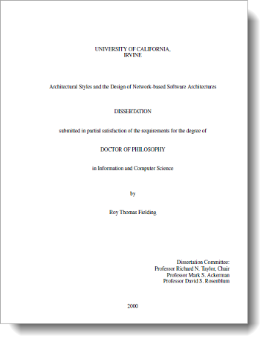
Representational State Transfer (REST)
Coined by the dissertation of Roy Fielding (2000)
  Roy Fielding: one of the main authors of the HTTP spezification
Goal: Architectural approach
  Coming back to basic Web-Technologies by simplification of distributed, web-based systems
Communication between Client and Webserver: through exchange of HTTP-messages using HTTP methods (GET, PUT, …)
Fielding, R. T. (2000): Architectural Styles and the Design of Network-based Software Architectures. http://www.ics.uci.edu/~fielding/pubs/dissertation/top.htm (2017-12-10)
Notes:
REST (Representational State Transfer) is a term coined by Roy Fielding in his doctoral dissertation to describe an architectural style for “distributed hypermedia systems” such as the Worldwide Web that are to have desirable characteristics including separation of concerns, scalability, resiliency, visibility, and reliability.

Slide 26
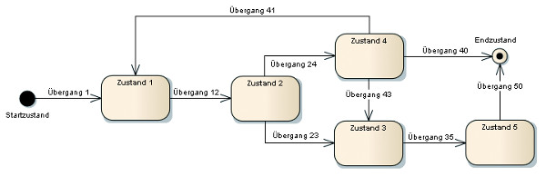
Basic concept
The central idea is the resource (i.e. document, image, temporal service, …) , which is accessible (possibly can be manipulated) via a Uniform Resource Identifiers (URI or URL) and can be connected to other resources.
A resource can be a document, a photo, a database extract or anything else.
Reaching a resource means receiving a representation. Fielding (2000): “A representation is a sequence of bytes, plus representation metadata to describe those bytes. … The data format of a representation is known as a media type.”
Manipulating a resource means manipulating a representation (on client side) and sending it back to the resource - in the hope that the resource will then be updated (or deleted).
UML State Chart: The model of a finite-state machine (FSM)
https://jaxenter.de/wer-rest-will-muss-mit-hateoas-ernst-machen-489 [2023-03-12]
Notes:
REST components communicate by transferring a representation of a resource
in a format matching one of an evolving set of standard data types, selected dynamically
based on the capabilities or desires of the recipient and the nature of the resource. Whether
the representation is in the same format as the raw source, or is derived from the source,
remains hidden behind the interface.

Slide 27
HTTP Methods
Operation | CRUD | Description
POST | Create | Create resources (i.e. POST adds a resource to a collection).
GET | Read | Retrieve a resource from the server. Data is only retrieved and not modified.
PUT | Update | Replace a specific resource. Is also used as a create if the resource identified by the URI/URL does not exist yet.
PATCH | Update | Partially modify an existing resource. The request contains the data and instructions that have to be used for changing/modifying the resource.
DELETE | Delete | Remove the specific resource.
CRUD: Create, read, update, delete
Notes:
PATCH: In case JSON is the encoding format in the designated JSON merge patch format (RFC 7386).

Slide 28
Encodings
GML
HTML
GeoJSON
YAML

Slide 29

?
Structurierung, encoding and documenting of data
(i.e. representation of resources)

Slide 30
XML
General concept for describing and structuring of data
XML languages („namespaces“) are defined by XML Schema Definitions
Important for geodata: GML, CityGML, KML, etc.
Details beyond the scope of this workshop.
Attribute name
Attribute value
<country id=’1’>Afghanistan</country>
Start-Tag
Element Content
End-Tag

Slide 31
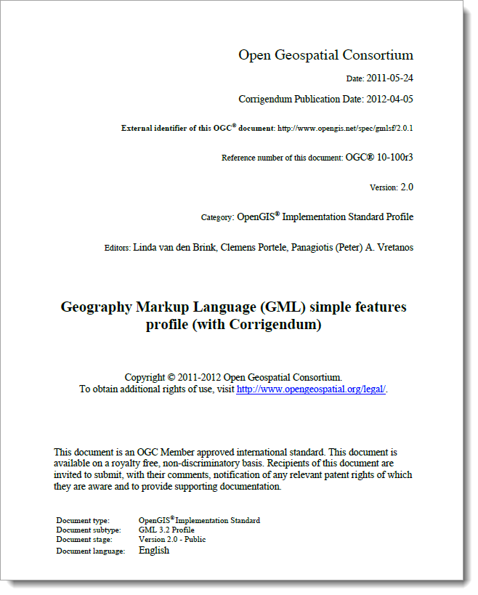
GML
van den Brink, L., Portele, C., Vretanos, P.: Geography Markup Language (GML) Simple Features Profile, 2012, https://docs.opengeospatial.org/is/17-069r3/17-069r3.html#GMLSF (88 pp)
Supporting MANY geometry types
Supporting arbitrary coordinate reference systems (CRS)
Details beyond the scope of this worshop.

Slide 32
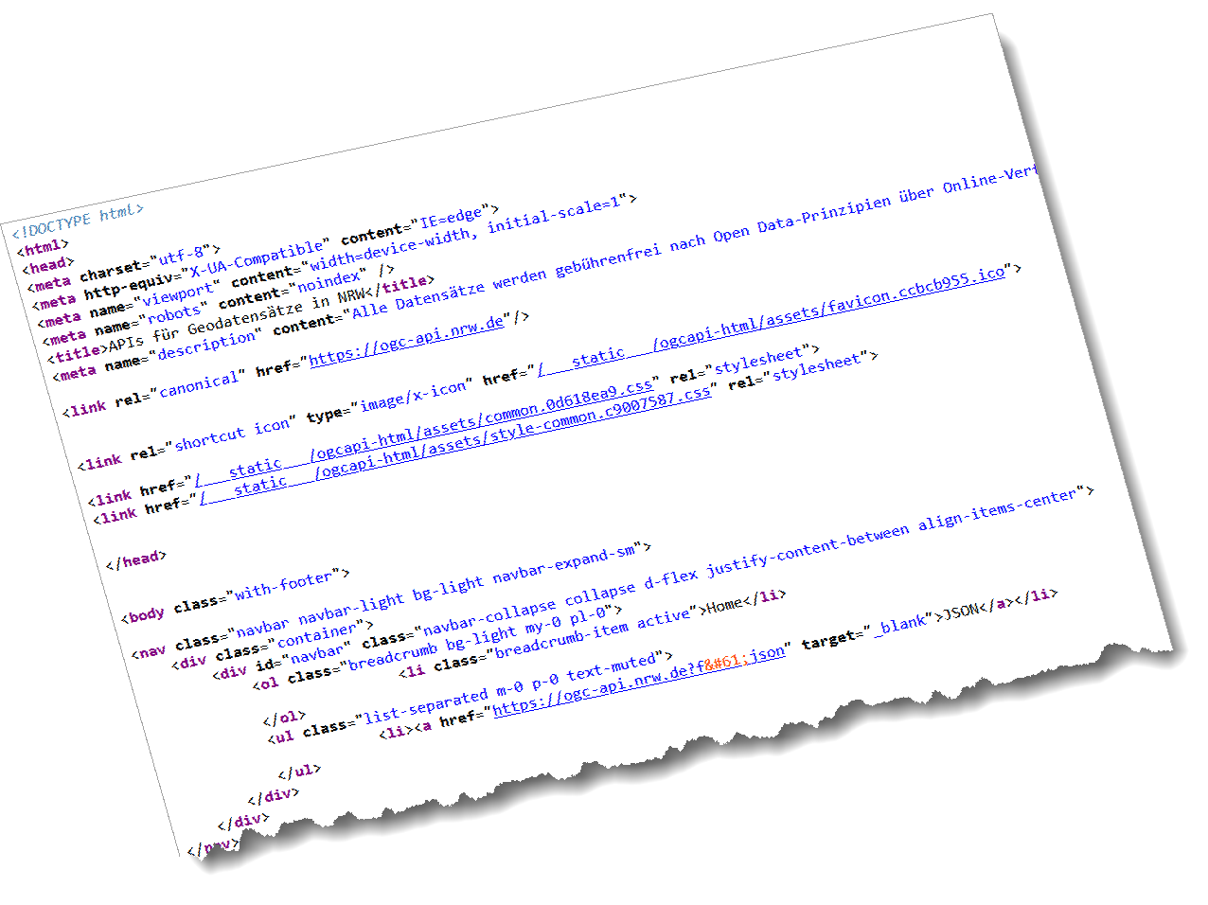
HTML
Beyond the scope of this workshop
See https://html.spec.whatwg.org/

Slide 33
GeoJSON
Standardized in RFC7946 (see https://www.rfc-editor.org/rfc/rfc7946)
Geometries:
  Point
  LineSTring
  Polygon
  MultiPoint
  MultiLineSTring
  MultiPolygon
  GeometryCollection
coordinate reference system for all GeoJSON coordinates is a geographic coordinate reference system, using the World Geodetic System 1984 (WGS 84), equivalent to urn:ogc:def:crs:OGC::CRS84

Slide 34
GeoJSON Example
Start of an array
here: many features / objects
Start of an object
here: some kind of feature collection
{
"type" : "FeatureCollection",
"links" : [ {
"href" : "http://data.example.com/collections/buildings/items?f=json",
"rel" : "self",
"type" : "application/geo+json",
"title" : "this document"
}, {
"href" : "http://data.example.com/collections/buildings/items?f=html",
"rel" : "alternate",
"type" : "text/html",
"title" : "this document as HTML"
}
, {
"href" : "http://data.example.com/collections/buildings/items?f=json&offset=10&limit=10",
"rel" : "next",
"type" : "application/geo+json",
"title" : "next page"
} ],
"timeStamp" : "2018-04-03T14:52:23Z",
"numberMatched" : 123,
"numberReturned" : 10,
"features" : [ {
"type" : "Feature",
"bbox": [-10.0, -10.0, 10.0, 10.0],
"id" : "123",
"geometry" : {
"type" : "Polygon",
"coordinates" : [ ... ]
},
"properties" : {
"function" : "residential",
"floors" : "2",
"lastUpdate" : "2015-08-01T12:34:56Z"
}
}, { ...
}, {
"type" : "Feature",
"id" : "132",
"geometry" : {
"type" : "Polygon",
"coordinates" : [ ... ]
},
"properties" : {
"function" : "public use",
"floors" : "10",
"lastUpdate" : "2013-12-03T10:15:37Z"
}
} ]
}
https://docs.opengeospatial.org/is/17-069r3/17-069r3.html#http_status_codes
Notes:
A GeoJSON object with the type "FeatureCollection" is a FeatureCollection object. A FeatureCollection object has a member with the name "features". The value of "features" is a JSON array. Each element of the array is a Feature object as defined above. It is possible for this array to be empty.
A position is an array of numbers. There MUST be two or more elements. The first two elements are longitude and latitude, or easting and northing, precisely in that order and using decimal numbers. Altitude or elevation MAY be included as an optional third element.
A GeoJSON object MAY have a member named "bbox" to include information on the coordinate range for its Geometries, Features, or FeatureCollections. The value of the bbox member MUST be an array of length 2*n where n is the number of dimensions represented in the contained geometries, with all axes of the most southwesterly point followed by all axes of the more northeasterly point. The axes order of a bbox follows the axes order of geometries.

Slide 35
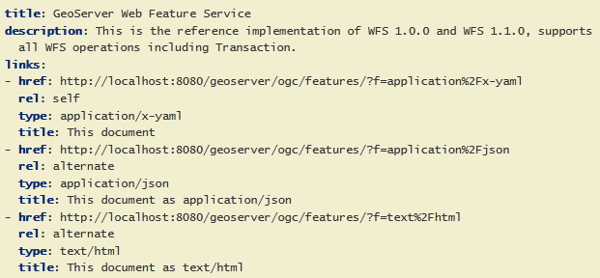
YAML
YAML Ain’t Markup Language, https://yaml.org/
Used to define APIs
“easier to read and write by humans”
Defining data structures by
  associative lists,
  lists (arrays) and
  single values (scalars)
Widely used:
Explore:
https://schemas.opengis.net/ogcapi/features/part1/1.0/openapi/schemas/
https://docs.geoserver.org/latest/en/user/community/ogc-api/features/index.html
Notes:
Lemonaki, D. (2022, November 11). What is YAML? The YML File Format. Retrieved March 20, 2024, from https://www.freecodecamp.org/news/what-is-yaml-the-yml-file-format/

Slide 36
Tradition Approach: The WFS API
GetCapabilities
GetFeaturetype
GetFeature

Slide 37
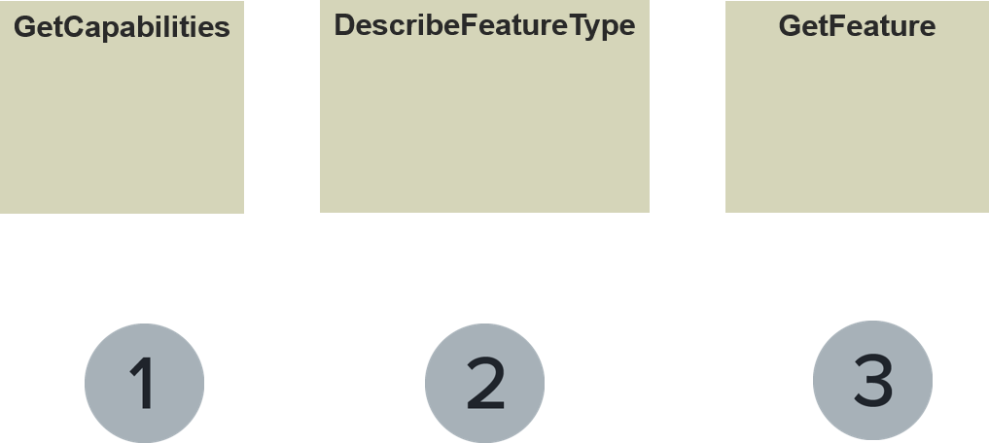
Web Feature Service
Web Map Service and the Web Feature Service found widespread use.
Building blocks of Spatial Data Infrastructures and are supported in almost every GIS
Extended by other OGC and/or ISO standards (GML, Filter Encoding, …)
Three basic steps for delivering geodata:

Slide 38
WFS Practise
Overview about the service: https://www.pegelonline.wsv.de/webservice/wfsAktuell;jsessionid=A9EEA6E33C2E274B14DC47614422FB51
Explore: GetCapabilities: https://www.pegelonline.wsv.de/webservices/gis/aktuell/wfs?service=wfs&version=1.1.0&request=GetCapabilities – you receive the service metadata
Explore: DescribeFeatureType: https://www.pegelonline.wsv.de/webservices/gis/aktuell/wfs?service=wfs&version=1.1.0&request=DescribeFeatureType&typeName=gk:waterlevels – you receive an XML Schema Definition of the properties of the feature class
Explore: GetFeature: https://www.pegelonline.wsv.de/webservices/gis/aktuell/wfs?service=wfs&version=1.1.0&request=GetFeature&typeName=gk:waterlevels
https://www.pegelonline.wsv.de/webservices/gis/aktuell/wfs?service=wfs&version=1.1.0&request=GetFeature&typeName=gk:waterlevels&outputFormat =json
https://www.pegelonline.wsv.de/webservices/gis/aktuell/wfs?service=wfs&version=1.1.0&request=GetFeature&typeName=gk:waterlevels&srsName=EPSG:31468

Slide 39
Open API Approach: The WFS API
GetCapabilities
GetFeature

Slide 40
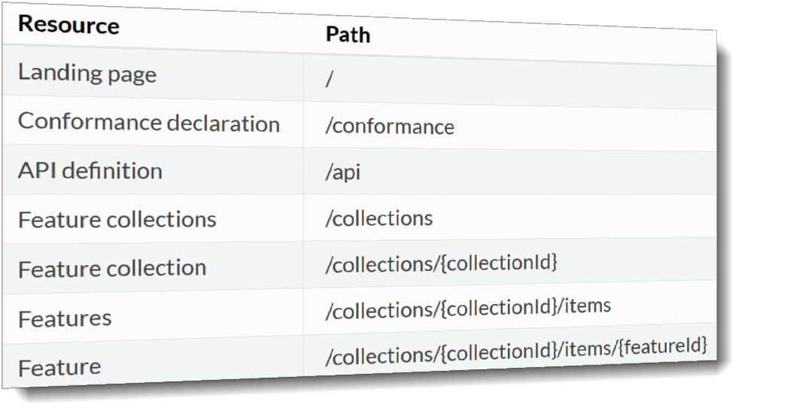
OGC API - Features
https://ogcapi.ogc.org/features/overview.html
provides access to collections of geospatial data in a consistent way - a common pattern to ensure consistency, enhanced interoperability and easier adoption (https://github.com/opengeospatial/OGC-Web-API-Guidelines)
Landing page
Conformance
API Definitions
Collections
Features
https://opengeospatial.github.io/e-learning/ogcapi-features/text/basic-main.html

Slide 41
Landing Page
The single top-level resource that serves as an entry point
  A client application needs to know the location of the landing page of the server.
  From the landing page, the client application can then retrieve links to the Conformance declaration, Collection and API definition paths.
provides links to:
  the API definition (link relations service-desc and service-doc),
  the Conformance declaration (path /conformance, link relation conformance), and
  the Collections (path /collections, link relation data).

Slide 42
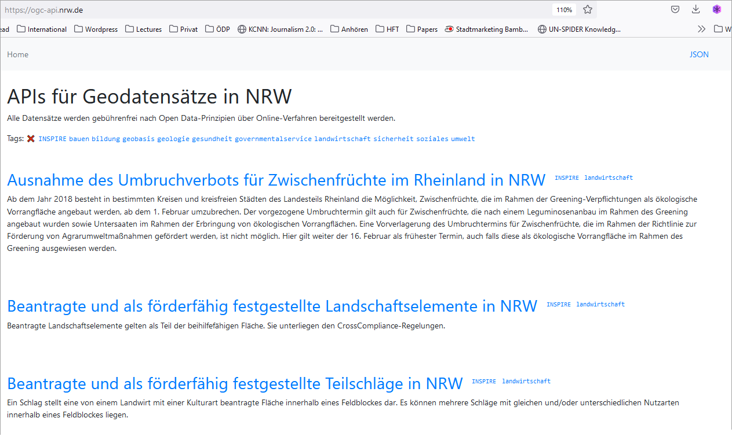
Practice
https://ogc-api.nrw.de/
Scroll down to „Daten des Liegenschaftskatasters“ or go directly to https://ogc-api.nrw.de/lika/v1.
Alternatively:
https://www.geoportal.rlp.de/spatial-objects/

Slide 43
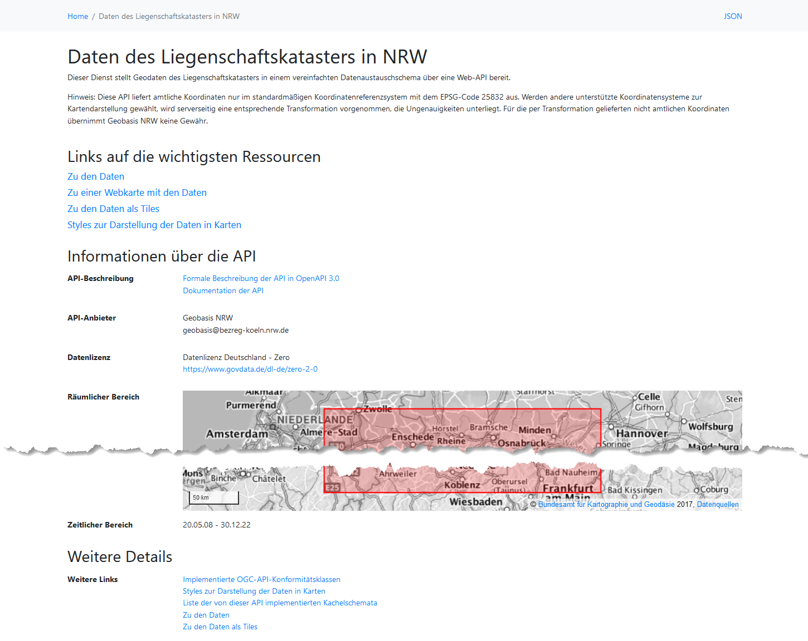
Standardized API related links:
  the API definition (“Dokumentation der API”),
  the Conformance declaration (“Implementierte OGC-API-Konformitätsklassen”),
  Collections (“Zu den Daten”)
Furthermore
  license information,
  Link to the machine-readable encoding (“JSON”)

Slide 44
Practice (alternatives)
https://www.geoportal.rlp.de/spatial-objects/ resp. https://www.geoportal.rlp.de/spatial-objects/67.
Standardized API related links:
  the API definition (“API Definition”, machine-readable JSON),
  the Conformance declaration – missing here,
  Collections
Furthermore
  license information (but empty),
  Link to the machine-readable encoding (“GeoJSON” and “XML”)
https://osdatahub.os.uk/docs

Slide 45
Conformance declaration
provides a list declaring the modules that are implemented by the API.
These modules are referred to as Conformance Classes.
The list of Conformance Classes is key to understanding and using an OGC Web API.

Slide 46
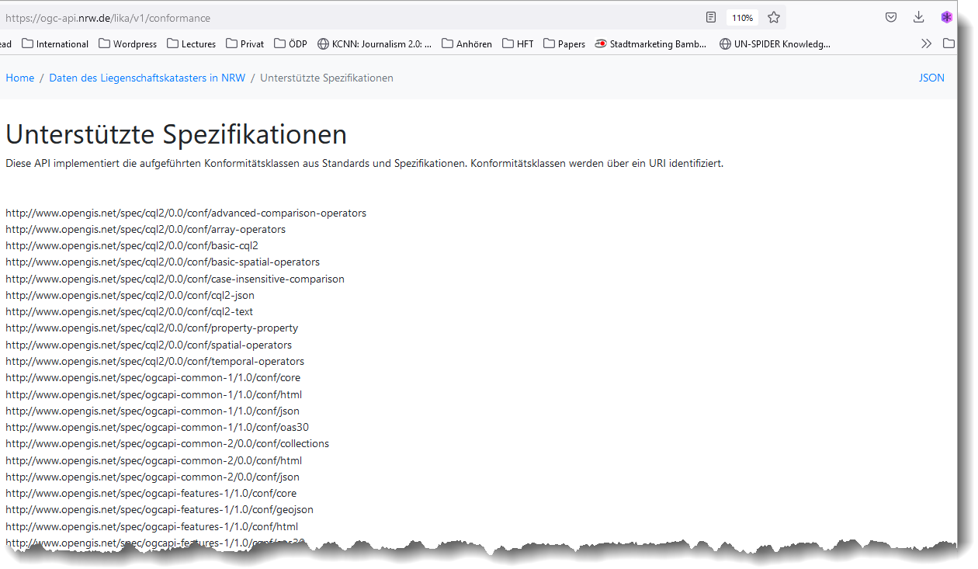
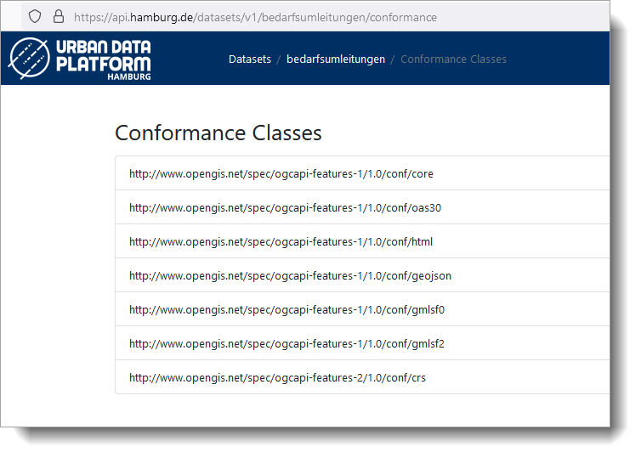
Practise
https://ogc-api.nrw.de/lika/v1/conformance
https://api.hamburg.de/datasets/v1/bedarfsumleitungen/conformance
From there: analyze conformance classes like
http://docs.opengeospatial.org/is/17-069r3/17-069r3.html#ats_geojson

Slide 47
Collections
Delivers collections of feature types being published by the service.
Each collection entry is described using the layer details of title, description, and further details, like number of features or geographic extent.
https://docs.ogc.org/is/17-069r3/17-069r3.html#_collections_
If external schemas (XSD, JSON Schema, RDF Schema) or descriptions for the dataset exist that provide information about the structure or semantics of the data, a 200-response SHOULD include links to each of those resources in the links property of the response

Slide 48
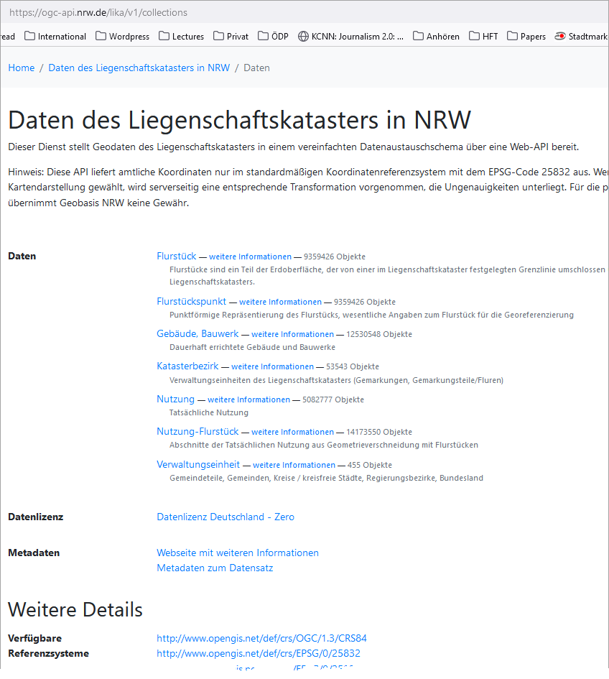
Practice
https://ogc-api.nrw.de/lika/v1/collections
Analyze the information provided:
The different collections
The machine-readable JSON-encoded

Slide 49
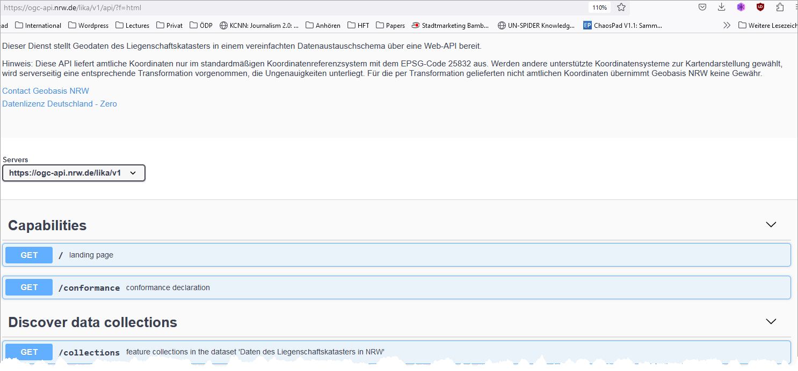
API definition
https://ogc-api.nrw.de/lika/v1/api/?f=html

Slide 50
Features (items)
For each feature collection, the links property of the collection SHOULD include an item for each supported encoding with a link to the collection resource

Slide 51
Practice
Rules
pygeoapi
Geoserver

Slide 52
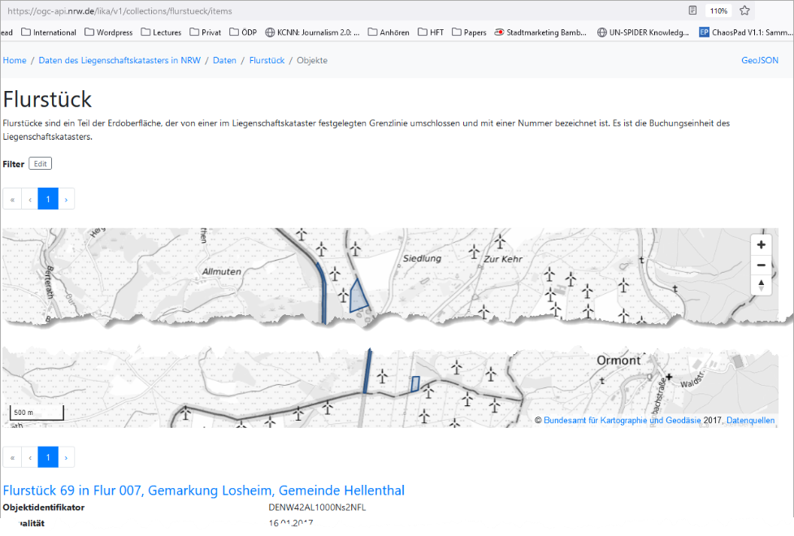
Practice
https://ogc-api.nrw.de/lika/v1/collections/flurstueck/items
From there click on one of the linked items like:
https://ogc-api.nrw.de/lika/v1/collections/flurstueck/items/05439400700069______?f=html

Slide 53
Implement your server
Rules
pygeoapi
Geoserver

Slide 54
Rules - Design Principles
Don’t Reinvent: For aspects and functional capabilities that are already solved in main-stream IT and meet geospatial community requirements, simply adopt these API elements. Focus instead on geo-centric and domain specific requirements to create new APIs or extend existing APIs
Keep the API Simple and Intuitive: Make the implementer of the API successful as quickly as possible. Avoid astonishment by defining a (default) behavior of the Web API that is predicable by the users (see principle #23).
Use Well-Known Resource Types: Identify your resource types and reuse existing definitions from the OGC Naming Authority resource type register (to be established). Encodings of resource types should be associated with an IANA registered media type. For more guidance see Principle #16.
Principle #4 – Construct consistent URIs: Great Web APIs look like they were designed by a single team. The most obvious properties of an API are the access paths and the URL templates which define them. Therefore, OGC conventions for the construction of access path templates are essential.
Put Selection Criteria behind the ‘?’
Error Handling and use of HTTP Status Codes: use appropriate HTTP status codes and offer human readable description
…
https://github.com/opengeospatial/OGC-Web-API-Guidelines

Slide 55
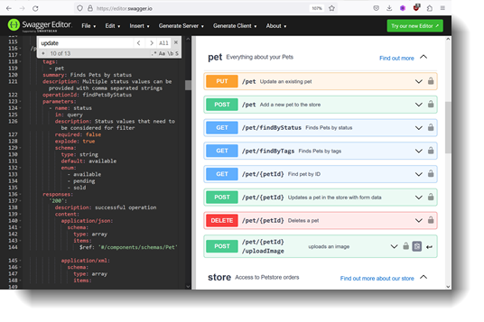
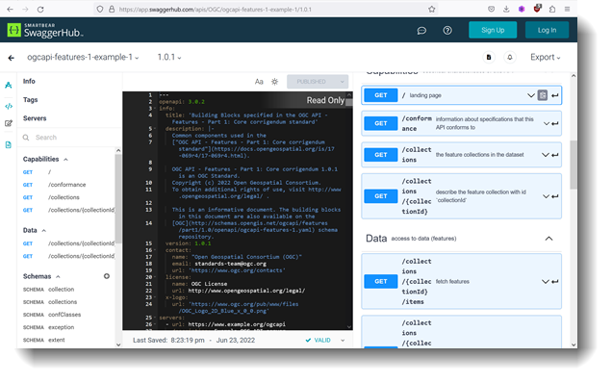
Swagger
The open source tool itself: https://editor.swagger.io/
Now with definitions for the OGC specific API: https://app.swaggerhub.com/apis/OGC/ogcapi-features-1-example-1/1.0.1

Slide 56
Open Source Implementations
pygeoapi
  https://pygeoapi.io/
  provides the capability for organizations to deploy a RESTful OGC API endpoint using OpenAPI, GeoJSON, and HTML.
  pygeoapi is open source and released under an MIT license.
OGC API Extension
  https://docs.geoserver.org/latest/en/user/community/ogc-api/index.html
  „The modules are still in their infancy, there is a set of activities that could help their development”
MapServer: https://mapserver.org/ogc/ogc_api.html
Ldproxy:
  https://interactive-instruments.github.io/ldproxy/ and https://github.com/interactive-instruments/ldproxy
  allows a quick set up of Web APIs that make geospatial data available to remote servers or to your own applications via HTTP.
deegree - deegree OGC API - Features Implementation:
  https://github.com/deegree/deegree-ogcapi
  “compliant to the latest OGC Standards called OGC API - Features based on deegree webservices API.
  Sponsored by state of Hamburg and Brandenburg

Slide 57
Certified products
Regarding OPC API Features: https://www.ogc.org/resources/certified-products/?display_opt=1&specid=1022
Regarding OGC API Environmental data: https://www.ogc.org/resources/certified-products/?display_opt=1&specid=1247
  So far: pygeoapi 0.9.0 [2023-08-11]

Slide 58
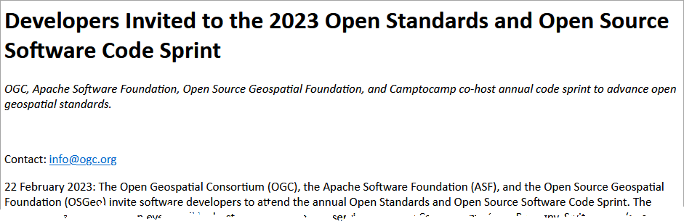
Open Source Implementations
Still much work to do:
April 25-27, 2023
“indicate whether you wish
to be considered for
Travel Support Funding”
https://developer.ogc.org/sprints/20/?utm_source=phplist910&utm_medium=email&utm_content=HTML&utm_campaign=Developers+Invited+to+the+2023+Open+Standards+and+Open+Source+Software+Code+Sprint

Slide 59
Summary
Significant move from traditional API to Open API
Taking up building blocks of the World Wide Web
New things to learn and to discover

Slide 60
Summary
Modern APIs are close to the original ideas of web resources and of HTTP communication
A significant move from traditional OGC standards (WMS, WFS, WCS, CSW…) to state-of-the-art API concepts
Easier and direct access and search of geodata (both human-readable – HTML - and machine-readable – JSON -)
Custom modern web concepts (JavaScript, JSON)
Constructed as "building blocks" that can be used to assemble new APIs
Standardization and especially implementation still on the way.
A promising and important step.

Slide 61
References
https://ogcapi.ogc.org/features/
https://opengeospatial.github.io/e-learning/ogcapi-features/text/basic-main.html
Emde, A. 2021. Der neue OGC API Features Standard, wie ist der Stand und was ist mit Open Source Geospatial Software möglich. FOSSGIS Konferenz 2021: Online-Event, 06.–09. Juni 2021, FOSSGIS e.V. et al., 2021. https://doi.org/10.5446/53905
Fielding, R. T., 2000. Architectural Styles and the Design of Network-based Software Architectures. https://www.ics.uci.edu/~fielding/pubs/dissertation/top.htm
Hobona, G., 2020a. OGC APIs – An Introduction. https://inspire.ec.europa.eu/sites/default/files/ogc_apis_introduction.pdf
Hobona, G., 2020b. OGC APIs and the evolution of OGC standards - an update. FOSS4G UK Online 2020 - Sentinel, FOSS4G et al., 2020. https://doi.org/10.5446/14056
Open Geospatial Consortium (OGC), 2011. OGC Reference Model. https://www.ogc.org/standards/orm [2023-01-11]
Retterath, A., 2020. OGC API – Die zukünftige Architektur der OGC-Dienste. https://wiki.gdi-de.org/display/akgeod/OGC+API

Slide 62
Your Take-Away: Acronyms used
HTTP – Hypertext Transfer Protocol
Content Types – describes the encoding / format of the resource transfered by HTTP (http://www.rfc-editor.org/rfc/rfc1521.txt)
URI – Uniform Resource Identifier (http://www.rfc-editor.org/rfc/rfc2396.txt) and URL – Uniform Resource Locator
CGI – Common Gateway Interface (http://www.rfc-editor.org/rfc/rfc3875.txt)
DBMS – Database Management System
SQL – Structured Query Language (manipulating / Querying databases)
Port
YAML
JSON
XML, GML

